Slide 1
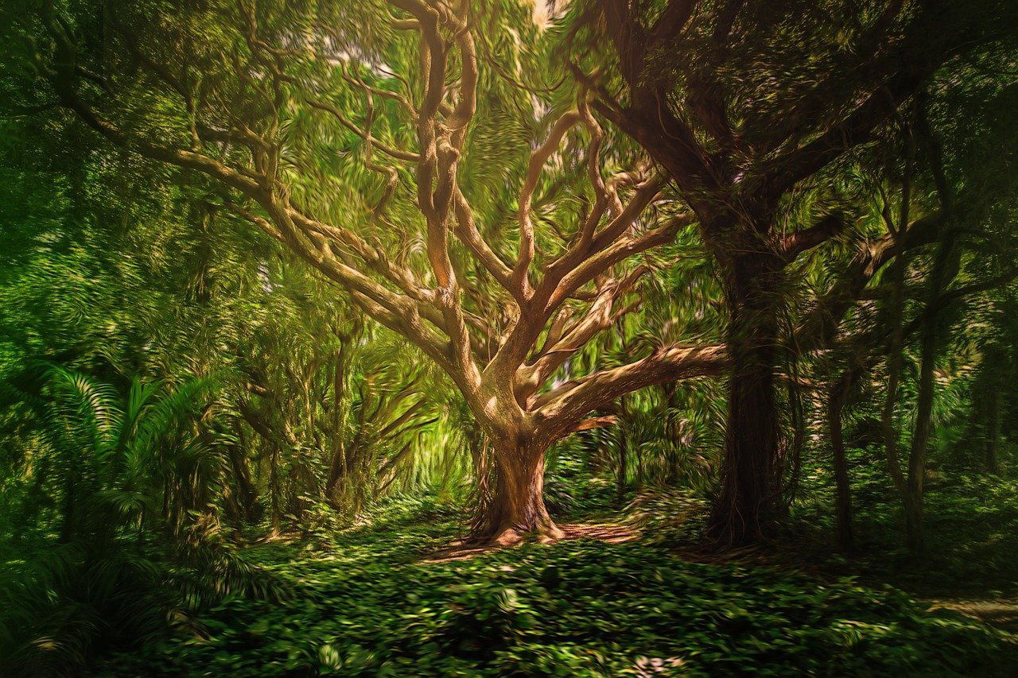
Tree plantation

Slide 2
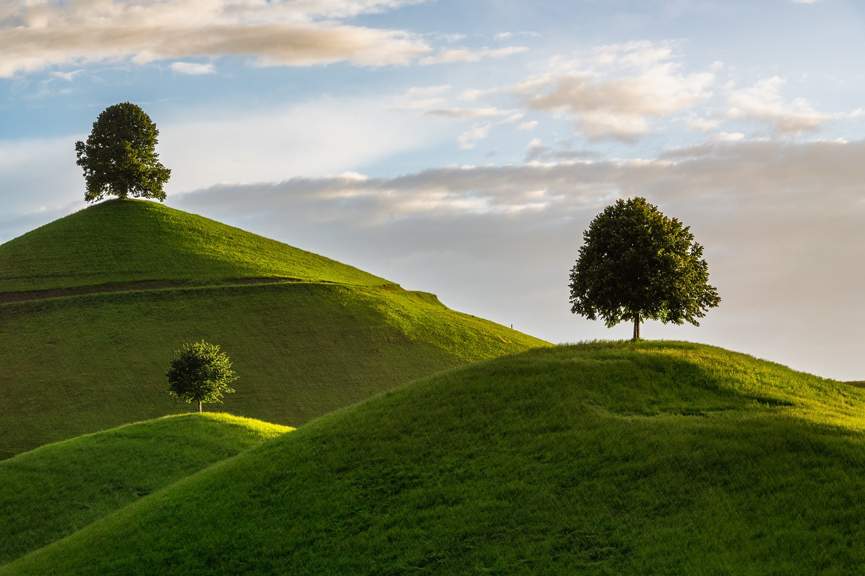
A tree plantation, forest plantation, plantation forest, timber plantation or tree farm is a forest planted for high volume production of wood
What is tree plantation?
Tree plantation is very necessary because trees provide oxygen to the environment and make the air quality better.
If more trees are planted, then the world's environment will become a safer place to live in.
Tree plantation also reduces pollution, thus making the life of future generations secure.

Slide 3

Trees improve air quality by filtering pollutants and releasing oxygen.
They also help reduce the urban heat island effect, which can reduce the need for air conditioning and heating. Trees can also:
why should plant trees?
Reduce storm water runoff, which can reduce erosion and pollution in waterways
Provide food, protection, and homes for wildlife

Slide 4
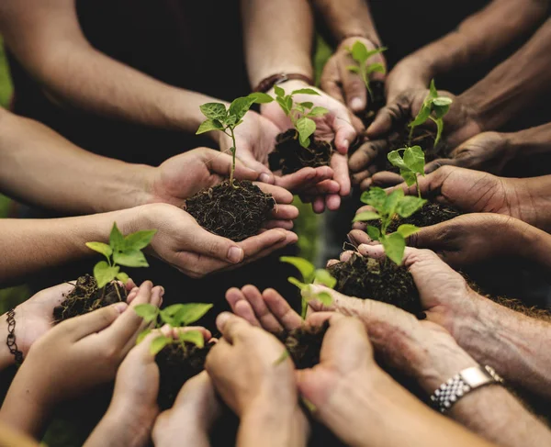
The best time to plant trees is generally between autumn and spring
Avoid planting in frozen or waterlogged soil
Best time for planting trees
Planting in soil that's too hard to dig in or has water sitting on top is not recommended
Container-grown plants: Can be planted at any time of year, but are easier to care for if planted in autumn or winter

Slide 5
Trees absorb harmful pollutants like carbon dioxide, ozone, and sulfur dioxide, and filter the air by trapping particulates in their leaves
Trees capture and store carbon dioxide from the atmosphere, which helps address climate change.
Benefits of planting trees
Trees provide food, shelter, and homes for many species of birds, mammals, insects, and plants.
Trees slow down the fall of rain and soak up water, which can help prevent flooding. A single mature tree can absorb up to 450 liters of water per day

Slide 6
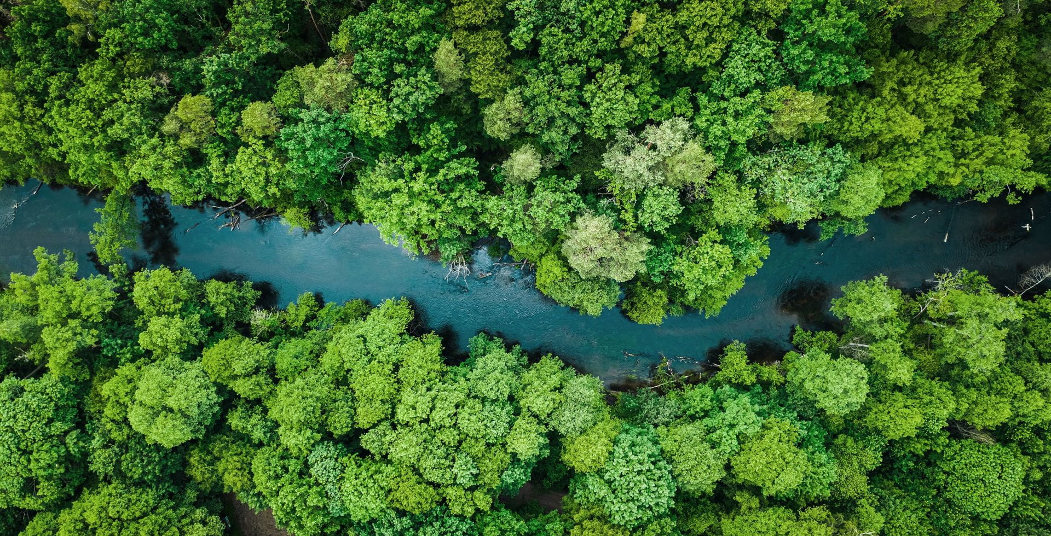
Trees and shrubs can reduce noise pollution.
Tree-lined streets can make streets appear narrower and increase traffic safety.
Benefits of planting trees
Well-placed trees can reduce cooling costs in the summer and increase the value of a home.
Trees can reduce the urban heat island effect by providing shade and reducing the amount of sunlight that reaches buildings and parking lots.

Slide 7
Trees and shrubs can reduce noise pollution.
Tree-lined streets can make streets appear narrower and increase traffic safety.
Benefits of planting trees
Well-placed trees can reduce cooling costs in the summer and increase the value of a home
Trees can reduce the urban heat island effect by providing shade and reducing the amount of sunlight that reaches buildings and parking lots.

Slide 8
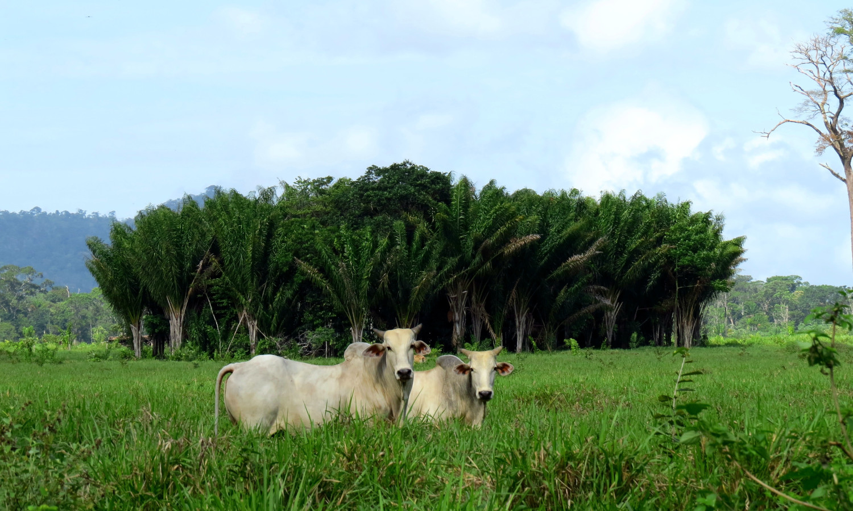
Trees are essential to human well-being and the environment in many ways
Conserving soil: Trees help prevent soil erosion.
Uses of tree in our life
Supporting mental health: Trees can have a positive effect on mental health.
Supporting local communities: Trees provide economic, social, and environmental benefits to local communities.

Slide 9
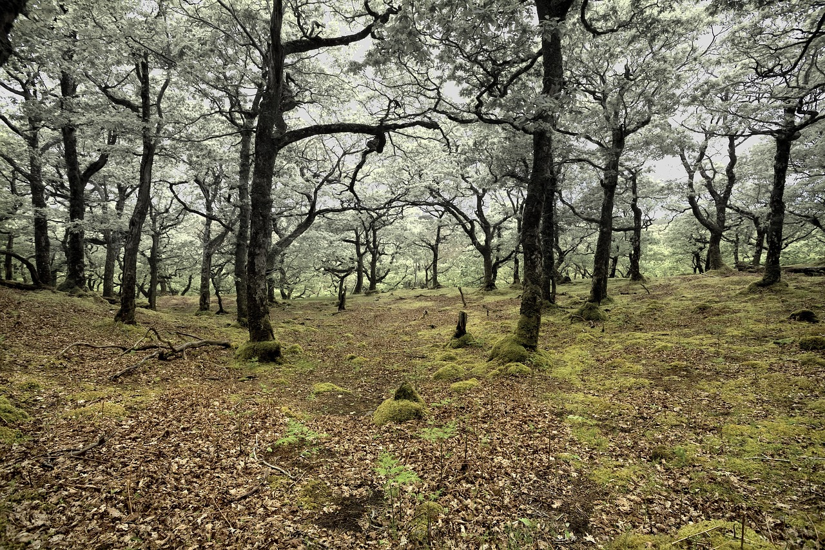
Deforestation is the process of clearing or thinning forests for other uses, such as agriculture, mining, or urbanization
Deforestation is the deliberate, natural, or accidental removal of trees or other plant life from an area
What is deforestation?
It can occur in any area with a dense population of trees, but most deforestation happens in the Amazon rainforest
The United Nations estimates that about 12 million hectares of forest are destroyed each year.

Slide 10
Soil erosion: Without the roots of trees and other vegetation to hold the soil in place, rain and wind can wash or blow away the topsoil.
Loss of biodiversity: Deforestation reduces the number of species in an ecosystem
Effects of deforestation
Habitat loss: Deforestation destroys the homes of many species, leading to population decline or extinction
Water pollution: Deforestation can pollute water.

Slide 11
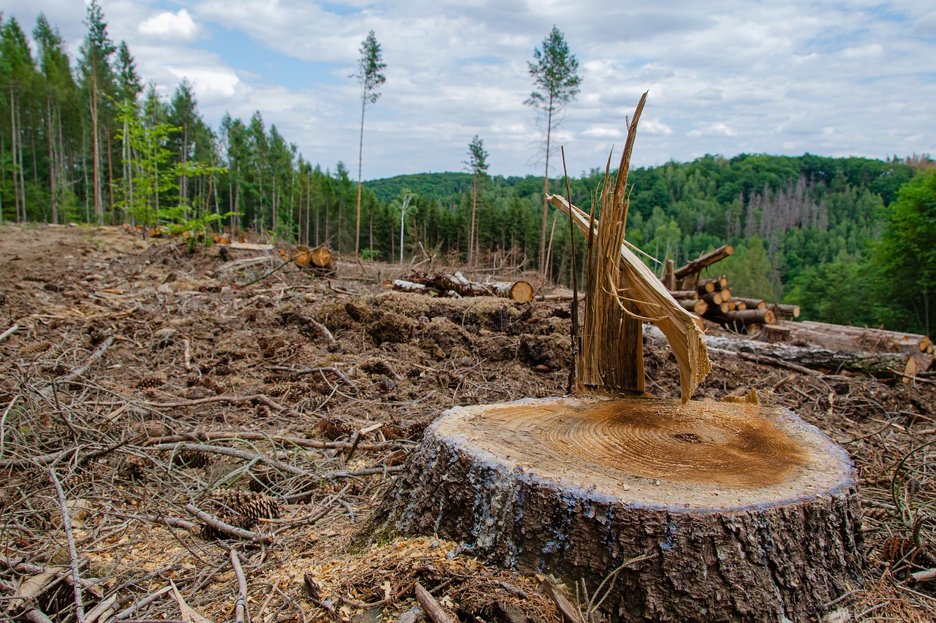
Human-wildlife conflict: Deforestation increases the likelihood of conflict between humans and wildlife.
Job loss: Deforestation can lead to job losses
Effects of deforestation
Loss of renewable resources: Deforestation can destroy potential renewable resources.
Deforestation harms biomass and worsens climate change

Slide 12
Adopt sustainable practices
Communities are more likely to adopt sustainable practices when they are directly involved
Promote eco forestry
Sustainable forestry can help curb deforestation and climate change.
How to stop deforestation?
Look for products that are FSC-certified, which means the wood is traceable to a sustainably managed forest
Reduce paper use

Slide 13
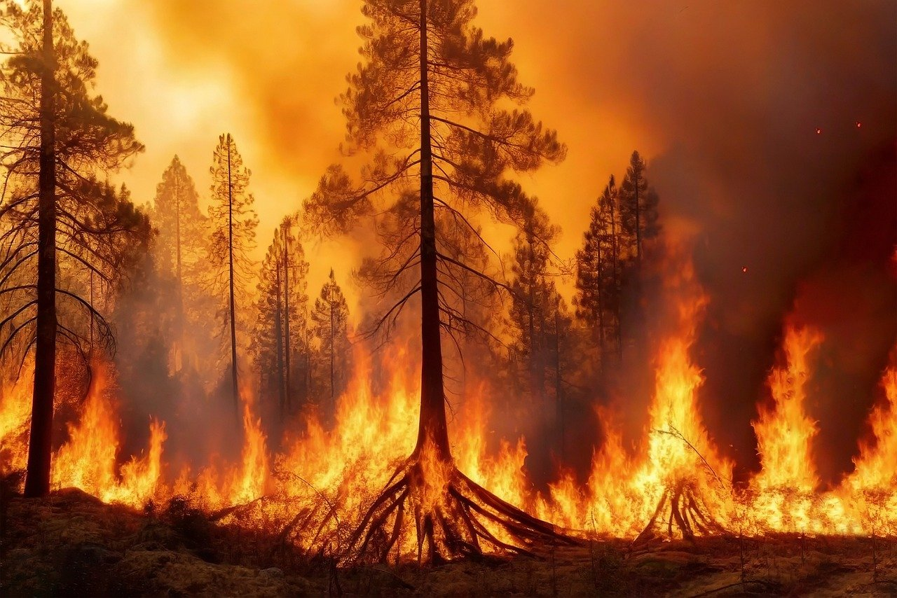
Eat less meat
Cattle ranching is a major cause of deforestation, especially in the Amazon rainforest
Choose sustainably sourced products
How to stop deforestation?
Consume less, avoid single-use packaging, and choose recycled or responsibly-produced wood products.
Adopt sustainable practices

Slide 14
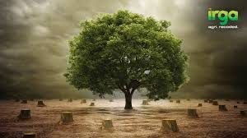
Climate change: Deforestation releases carbon dioxide into the atmosphere, which contributes to climate change and the greenhouse effect
Invasive species: Deforestation creates a vacuum in the ecosystem that can be filled by invasive species that are not native to the area
Effects of deforestation in animal life
Loss of potential medicines: Deforestation can lead to the loss of potential medicines
Habitat fragmentation: Deforestation divides forests into smaller, isolated patches, which can limit animal movement and reduce genetic diversity.

Slide 15
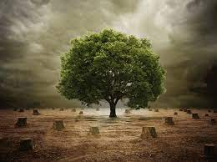
Recycle wood products: Using wood that has already been harvested reduces the demand for new wood
Support the grassroots: Support the grassroots
How to reduce deforestation?
Hold businesses accountable: Hold businesses accountable for their actions
Adopt sustainable practices: Choose sustainably sourced products, including wood products and other goods

Slide 16
Absorb carbon dioxide
Provide oxygen
Why forest are important
Harbor more than three quarters of terrestrial biodiversity
Support the livelihoods of millions of people worldwide

Slide 17
Promote tree growing: Encourage people, especially women, youth, and indigenous people, to grow trees that are climate resilient
Create partnerships: Form partnerships with the private sector, civil society, and NGOs to conserve forests
How we will be able to stop deforestation in Bangladesh?
Monitor forests: Increase the capacity of forestry research and analysis to monitor the state of forests, biodiversity, and ecosystem services
Implement laws and regulations: Ban clear cutting of forests and require planted trees to replace cut trees

Slide 18
Monitor forests: Increase the capacity of forestry research and analysis to monitor the state of forests, biodiversity, and ecosystem services
Buy responsibly: Buy certified wood products, recycle, and avoid palm oil
How we will be able to stop deforestation in Bangladesh?
Educate others: Educate others about deforestation
Address capacity constraints: Address the capacity constraints of farmers

Slide 19

Implement laws and regulations: Ban clear cutting of forests and require planted trees to replace cut trees
Prioritize agroforestry: Create policies that prioritize agroforestry and provide training for different types of agroforestry
How we will be able to stop deforestation in Bangladesh?
Plant more trees: Participate in tree-planting initiatives.
Implement laws and regulations: Ban clear cutting of forests and require planted trees to replace cut trees

Slide 20
How can we give the control of deforestation?
The best way to stop deforestation is replanting. Ban on cutting of trees and new trees and planting more. There should be an implementation of regulations of laws at organizational and governmental levels due to the extent of deforestation.

